Slide 1
CEGE0096: Geospatial Programming
Lecture 7: Vector and Raster Representations
Dr. Aldo Lipani

Slide 2
The Modelling Process – Waterfall Model
Application Domain
1
Application Domain Model
2
initial
study
Conceptual
Model
Computational Models
3
system
analysis
Logical Model
4
system
design
Physical
Model
system
implementation
5

Slide 3
Coordinate Reference Systems

Slide 4
Coordinate Reference Systems
In this module, we will predominantly use these two Coordinate Reference Systems (CRS):
World Geodesic System (WGS)
British National Grid (BNG)

Slide 5
World Geodesic System
This refers to the last one made in 1984 (EPSG:4326).
This coordinate system is located at the earth’s center of mass;
it models Earth as an ellipsoid.
This is a geodetic coordinate system based on the WGS 84 datum:
Latitude: The angular distance of a place north or south of the equator;
Longitude: The angular distance of a place east or west of the Greenwich meridian.
These are often provided in sexagesimal notation (in degrees, minutes, seconds):
051°31' 33.846 N 000° 7' 58.537 W

Slide 6
British National Grid
This is a local coordinate reference system used in Great Britain, known as OSGB36 (EPSG:27700).
It uses the transverse Mercator Projection.
It is based upon the OSGB 1936 datum:
Easting (Metres East of False Origin)
Northing (Metres North of False Origin)
Coordinates are represented as integers:
Easting: 529620 Northing: 182447

Slide 7
Projections

Slide 8
Projections

Slide 9
Pyproj

Slide 10
Pyproj
This is a Python package for cartographic projections and coordinate transformations.
This is usually imported as:
import pyproj
It uses PROJ.4 notation to define projections. However, unless we are defining our own projections, we can use EPSG (http://epsg.io) strings for standard projections.
wgs84 = pyproj.Proj('+init=EPSG:4326') # LatLon with WGS84 datum used by # GPS units and Google Earth osgb36 = pyproj.Proj('+init=EPSG:27700') # UK Ordnance Survey, 1936 datum
To transform coordinates from WGS to BNG we can simply use the method transform:
pyproj.transform(wgs84, osgb36, latitude, longitude)

Slide 11
Vector Representation

Slide 12
Vector Representation
A vector is a line segment (edge, wire) defined by its end points (vertices).
Line segments may be curved.
A 0D geometric entity
A 1D geometric entity.
A 2D geometric entity.

Slide 13
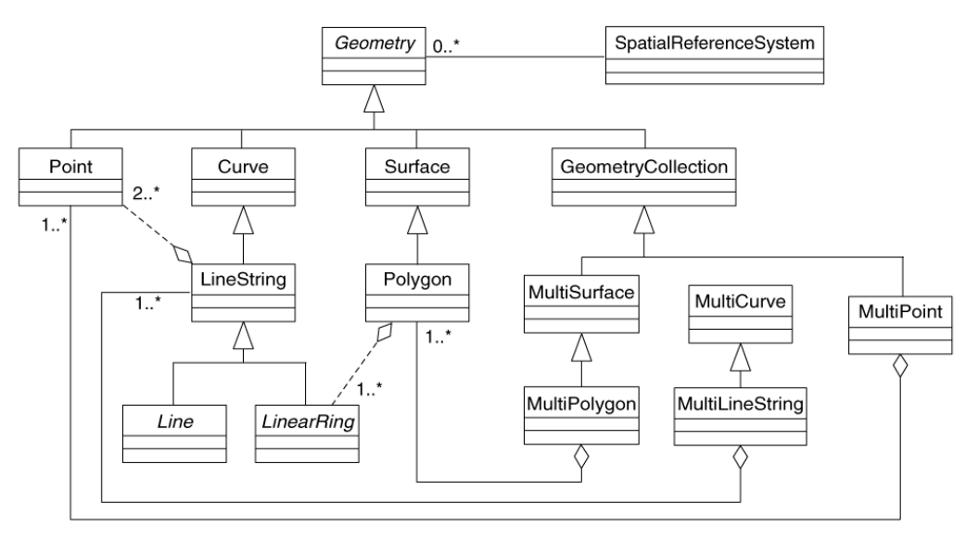
ISO 19125 Simple Feature Access
This standard has been developed by the Open Geospatial Consortium
Standardized by the International Standards Organization (ISO).
A standard class relationship among, points, line strings, and polygons.

Slide 14
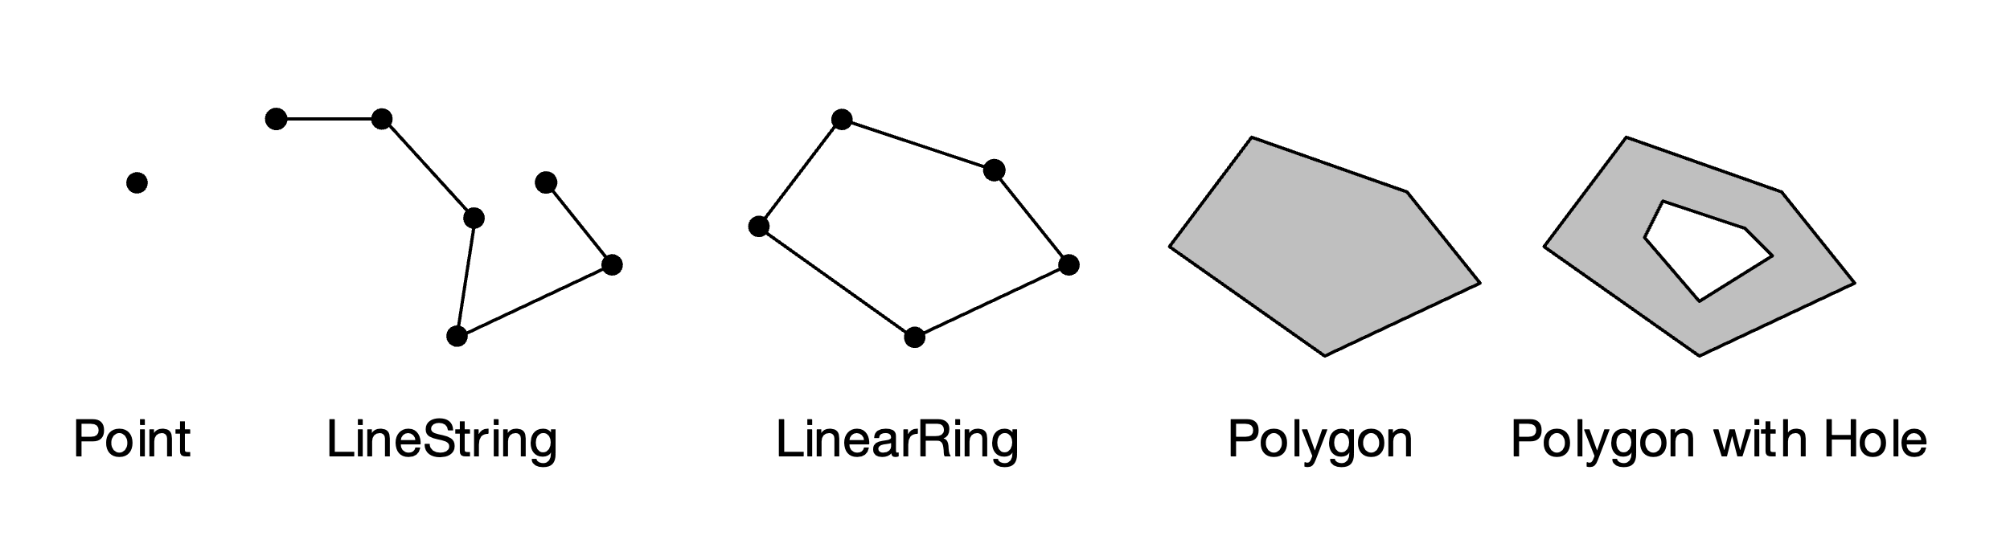
ISO 19125 Simple Feature Access (II)
Geometry is a parent class from which all other classes are inherited.
LineString is defined as an array of vertices (points).
LinearRing is a specialised class of LineString in which the last vertex is the same as the first one.
Polygon is a class defined by an external LinearRing and a list of internal LinearRings.

Slide 15
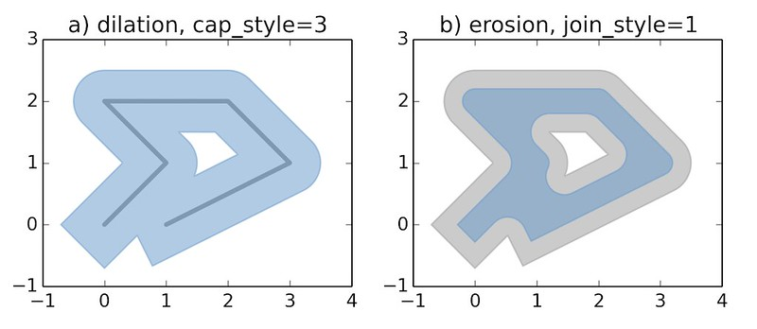
SHAPELY

Slide 16
Points
We can represent points in Python using the shapely geometry package.
from shapely.geometry import Point
We can create a point by passing the coordinates x and y:
pt1 = Point(0, 0)

Slide 17
Operations
A fundamental geospatial operation on point objects is to compute the distance to another point.
Using shapely, we can compute the Euclidean (or Cartesian) distance between two points:
pt2 = Point(1, 1) pt1.distance(pt2)

Slide 18
Operations (II)
Every geometry object in Shapely defines the following attributes.
To get the length of a geometric object:
pt1.length
To get the area:
pt1.area
To get the minimum bounding rectangle:
pt1.bounds

Slide 19
Operations (III)
To return the geometry type:
pt1.geom_type
To compute the distance from the two furthest points of the objects:
pt1.hausdorff_distance
To get the coordinates as an array:
pt1.xy

Slide 20
Line Strings
Using the shapely geometry, we can use the LineString class to represent a series of segments all connected to each other.
from shapely.geometry import LineString
To create a segment, we can pass a list of two points as coordinates:
LineString([(0, 0), (1, 1)])
Or, two points: LineString([pt1, pt2])

Slide 21
Operations
Since the LineString class inherits from the Geometry class, it also has the same operators presented for the Point class.
However, the logic of these methods changes. For example, distance computes the minimum distance between the series of segments defining the LineString and a point:
line.distance(pt1)
Or, the attribute xy returns the series of coordinates as an array:
line.xy

Slide 22

LineString (II)
We can build more complicated LineString objects by passing more than two points. This will create multiple segments sequentially connected.
LineString([(0, 0), (1, 1), (1, 0), (0.6, 0.4)])

Slide 23
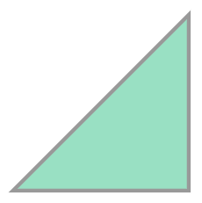
Polygon
Shapely also enables the creation of polygons.
from shapely.geometry import Polygon
Polygon([(0, 0), (1,1), (1,0)])

Slide 24
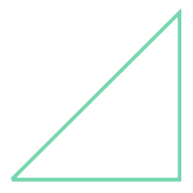
Operations
Like LineStrings, all attributes presented so far are still available for Polygons.
However, polygons implement a new attribute called exterior.
This returns the polygon’s perimeter as a LineString:
polygon.exterior

Slide 25
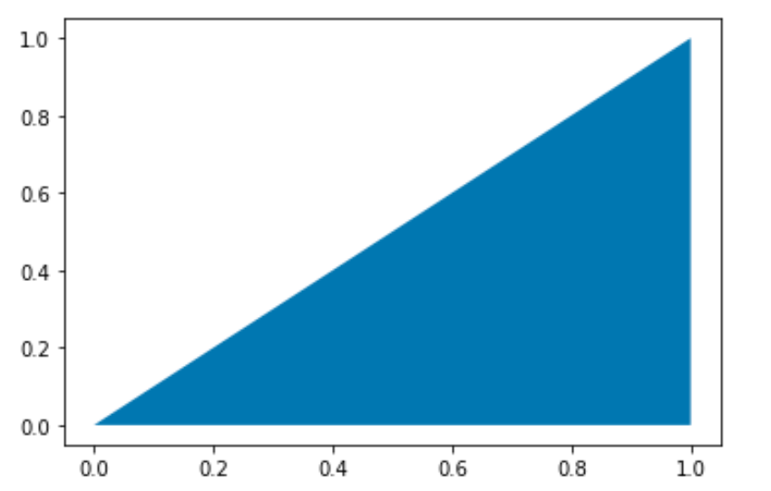
Plotting a Polygon in Matplotlib
We can easily plot a polygon using Matplotlib like:
x, y = polygon.exterior.xy plt.fill(x, y);

Slide 26
Topological Relationships
Topological relationships describe qualitative properties that characterise the relative position of spatial objects: disjoint, meet, overlap, and inside are a few examples.
We can use methods implemented by shapely classes to query the topological relationship between shapely objects.
To check if a point touches the polygon:
polygon.touches(pt1)
To check if a point is contained in a polygon:
polygon.contains(pt1)

Slide 27
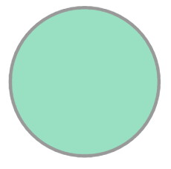
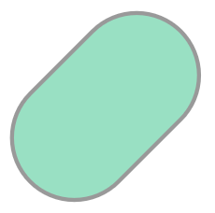
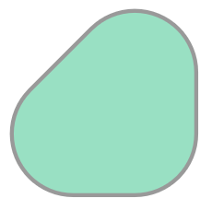
Geometric Operations
A buffering operation returns a Polygon around an object that is offset by a given distance:
pt1.buffer(1)
line.buffer(1)
polygon.buffer(1)

Slide 28
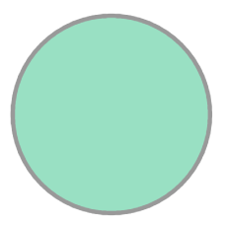
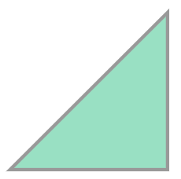
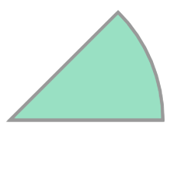
Geometric Operations (II)
We can intersect multiple shapes together to create a new shape:
pt1.buffer(1).intersection(polygon)

Slide 29
GeoPandas

Slide 30
GeoPandas
It is an open-source project to make working with geospatial data in Python easier.
import geopandas as gpd
GeoPandas extends the datatypes used by pandas to allow spatial operations on geometric types.
Geometric operations are performed by Shapely. And plotting by matplotlib.
GeoPandas implements two main data structures GeoSeries and GeoDataFrame. These are subclasses of Pandas Series and DataFrame.

Slide 31
GeoSeries
A GeoSeries is a vector where each entry in the vector is a set of shapes, corresponding to one observation. An entry may consist of only one shape.
GeoPandas supports shapely objects: Point, Lines, and Polygons.
Note that, like for the Pandas’ Series, all entries of a GeoSeries need to be of the same type.

Slide 32
Attributes
We can compute the area of each entry:
series.area
We can compute their bounds:
series.bounds
Its total bounds:
series.total_bounds
To get the shapely type:
series.geom_type

Slide 33
Methods
We can compute the distance to another object:
series.distance(pt1)
Returns a GeoSeries of centroids:
series.centroids()
Return a GeoSeries of points that are within each geometry:
series.representantive_points()
To change the coordinate reference system:
series.to_crs(crs)
To plot a series:
series.plot()

Slide 34
GeoDataFrame
A GeoDataFrame is a tabular data structure that contains GeoSeries.
The most important property of a GeoDataFrame is that it always has one GeoSeries column that holds a special status. This GeoSeries is referred to as geometry.
When a spatial method is applied to a GeoDataFrame or a special attribute like area is called, these commands will always act on the geometry column.
We can have multiple series in a GeoDataFrame acting as geometry, but only one can be considered at all times.

Slide 35
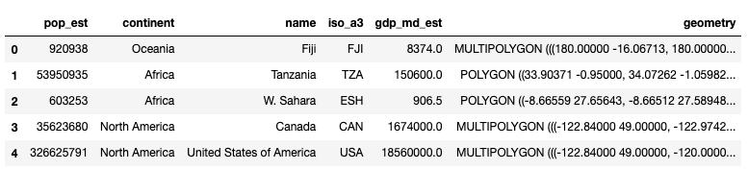
GeoDataFrame (II)
world = gpd.read_file(gpd.datasets.get_path('naturalearth_lowres')) world.head()
world.plot()
world.geometry.name

Slide 36
Raster Representation

Slide 37
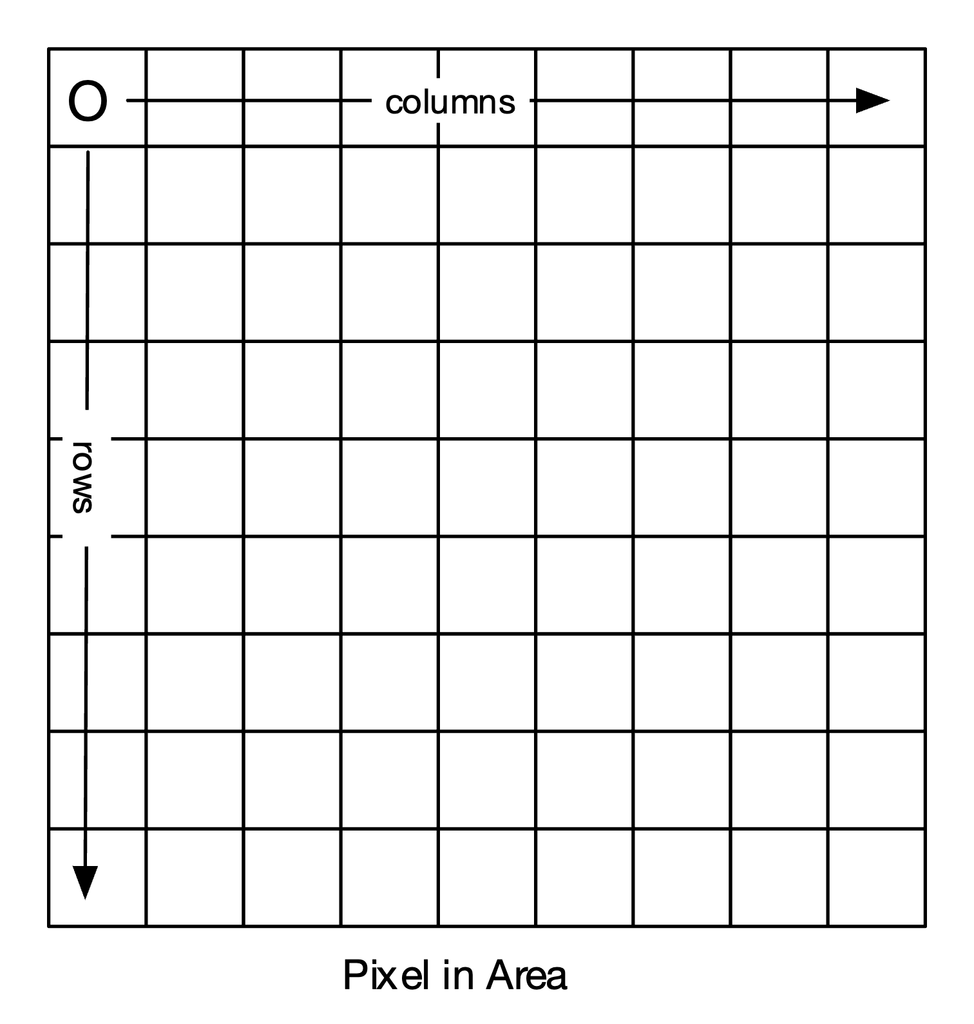
Raster Representation
In the raster model a surface is broken down into a continues regular arrangement of discrete cells known as pixels.

Slide 38
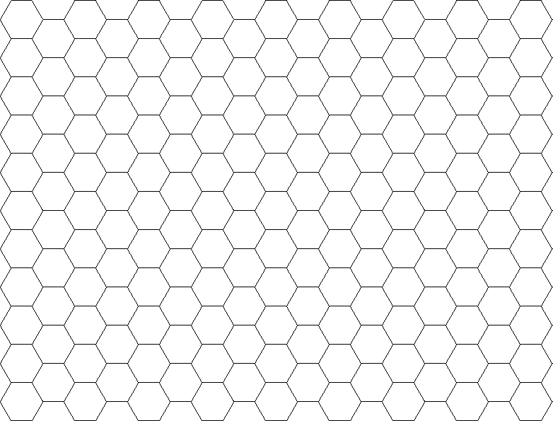
Raster Representation (II)
The regular pattern could either be a grid of equilateral triangles or hexagons:
In practice, 99% of the time, rasters are modelled as a grid of squares.

Slide 39
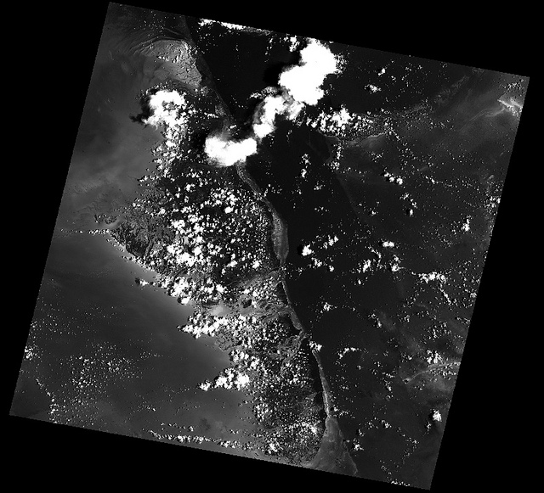
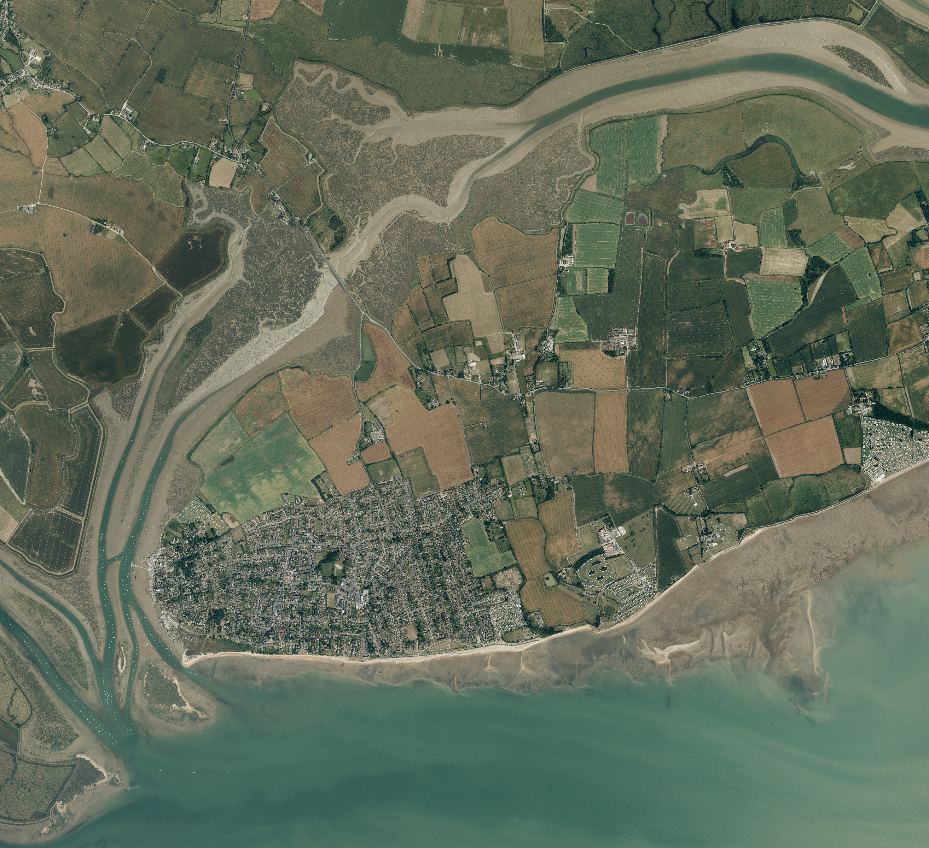
Practical Applications
The Raster model is widely used to represent
geospatial information.
Remote Observation, like satellite imagery:
Processed Information, like aerial imagery:

Slide 40
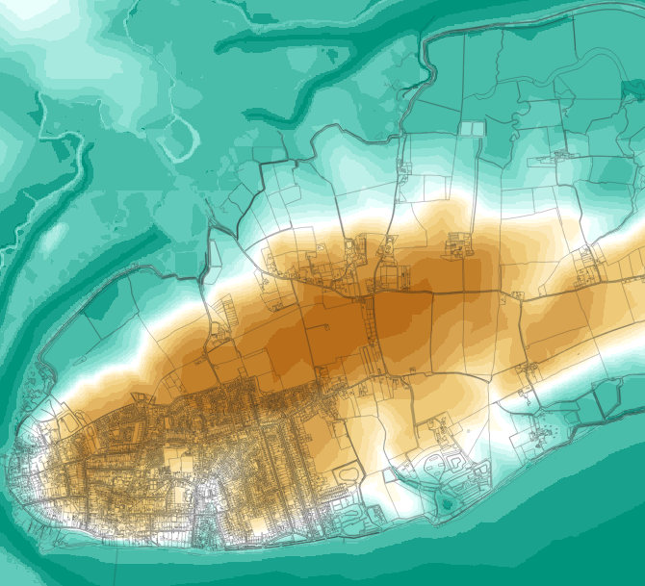
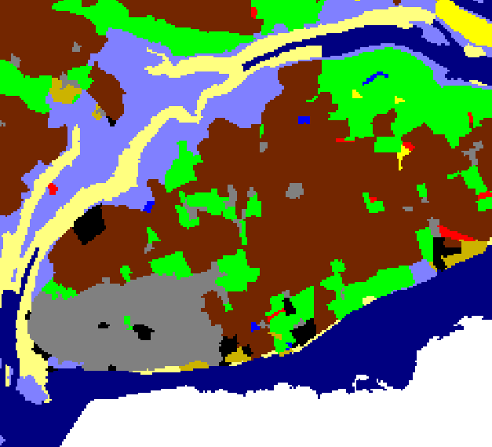
Practical Applications (II)
Modelling Continuous Fields, like digital elevation models:
Land Classification data

Slide 41
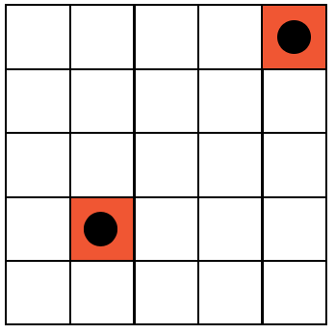
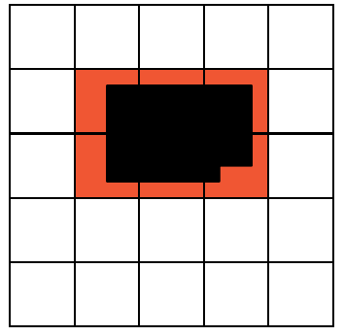
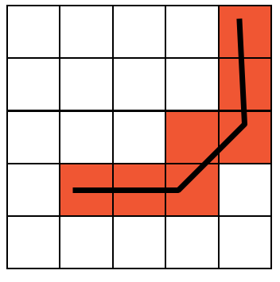
Modeling Discrete Features
Point, Line and Area Features are rasterised and represented as pixels in order to perform overlay operations.

Slide 42
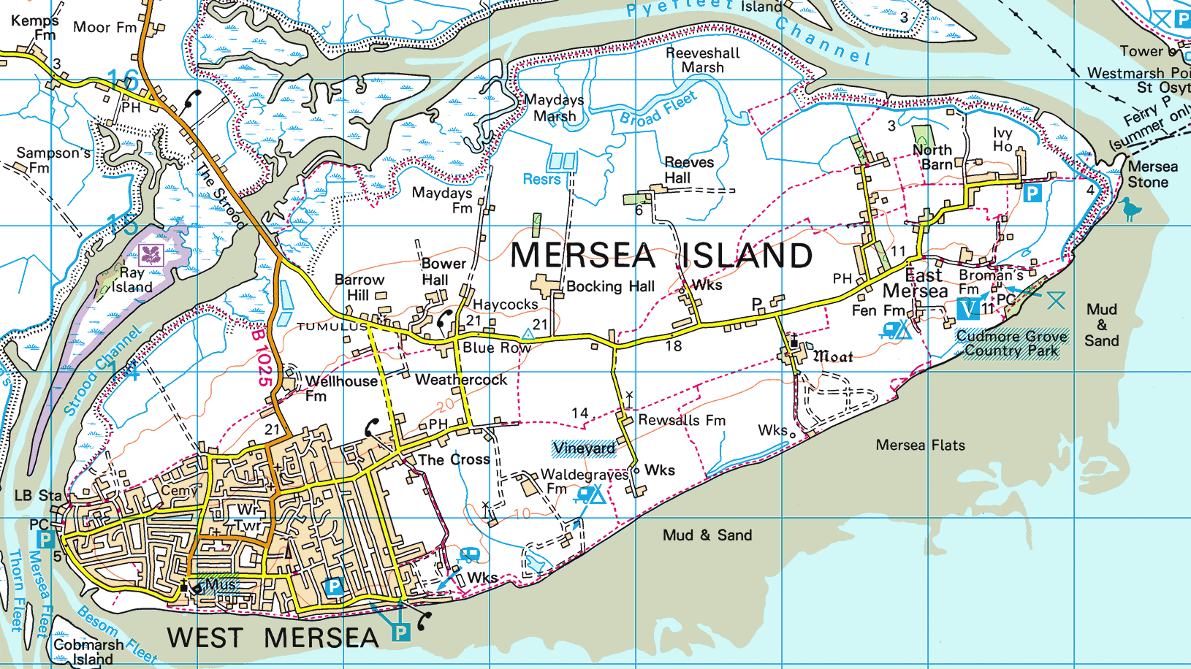
Cartographic Imagery
The Cartographer is an expert at communicating geospatial information to the map user.
Features are manually styled and labelled to provide maximum readability.

Slide 43
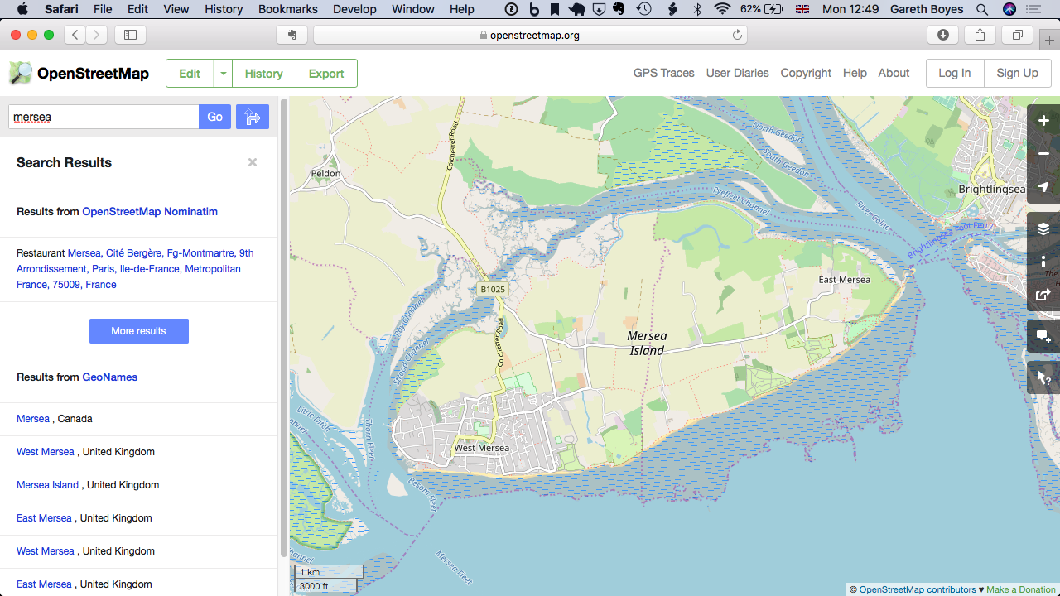
Map Tiles
Servers transform vector information and transmit rasterized map tiles to client devices:

Slide 44
Multi Criteria Decision Analysis
This analysis is used, for example, for site selection.
We first split a large area into discretised cells.
Each cell is given a value that is calculated according to the spatial relationship of that cell to a particular feature.
Then, we weigh the value of each cell in accordance with the decision-making criteria.
Sum the weighted values.

Slide 45
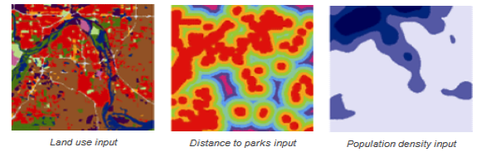
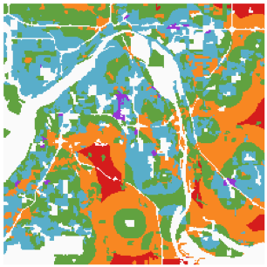
Map Algebra
Weighted overlay is an operation done with multiple raster layers.
Input 3 raster layers and determine weights:
The output shows the most suitable areas in red.
.5
+ .15
+ .35
=

Slide 46
Pixels
Each pixel in a raster is assigned a value that represents a property of the feature being modelled.
These values could be:
Boolean value
An integer:
Index
Ranking
A floating-point value:
Temperature
A colour component of a colour image

Slide 47
Area vs Point
The value of each pixel is either:
Pixel-Is-Area
Pixel-Is-Point
In Pixel-Is-Area, the value of the pixel represents a property of the feature that extends across the surface area of the pixel.
It could be an average, a maximum, or a minimum.
It could also be a discrete measurement taken at the centre of the pixel.
In Pixel-Is-Point, the value of the pixel represents a property of the feature measured at the top-left corner of the pixel.

Slide 48
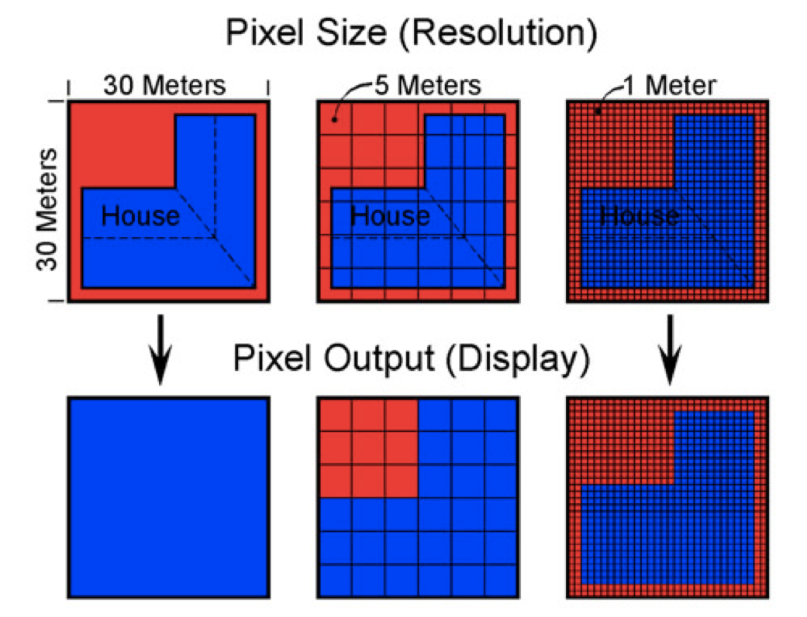
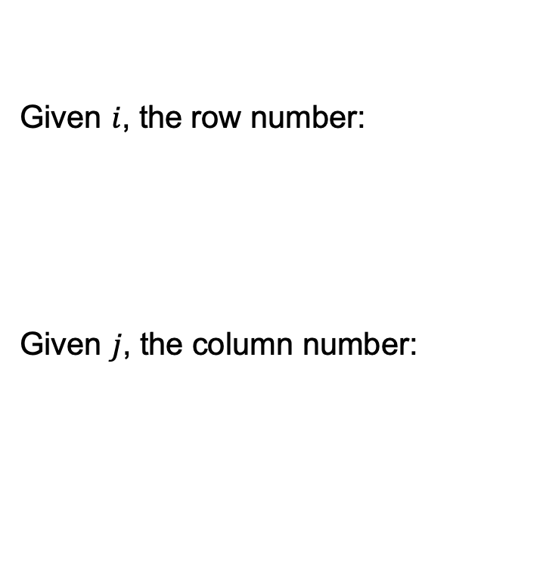
Resolution and Spatial Referencing
Given $i$, the row number:
Given $j$, the column number:

Slide 49
rasterio

Slide 50
Rasterio
Rasterio is a high-level package for reading and writing raster files.
import rasterio
It provides a Python API based on NumPy arrays.
It can manipulate various raster formats like GeoTiff and ASCII Raster Format.
We can open a raster file like:
dataset = rasterio.open("example.tiff")

Slide 51
Attributes and Plotting
To get the bounds of the dataset:
dataset.bounds
To get the data type of the dataset:
dataset.dtypes
To get the number of bands (layers of rasters):
dataset.count
The coordinate reference system:
dataset.crs
To plot a raster:
import rasterio.plot rasterio.plot.show(dataset)

Slide 52
File formats for Vector representation

Slide 53
GeoJSON
It is an open standard format designed for representing simple geographical features.
The features include points, lines, polygons, and combinations of them.
We can associate to each item attributes.
The coordinate reference system is the World Geodetic System 1984 (WGS 84) datum.
{
"type": "Feature",
"geometry": {
"type": "Point",
"coordinates": [125.6, 10.1]
},
"properties": {
"name": "Dinagat Islands"
}
}
Documentation: https://geojson.org/

Slide 54
Shapefile
It is a geospatial vector data format for GIS software.
It is developed and regulated by the Environmental Systems Research Institute (Esri).
It describes points, lines and polygons.
We can associate attributes to each item.
This is a multi-file format, and it requires at least the following 3 files:
.shp the shape file containing the feature geometry itself
.shx the shape index containing a positional index for quicker access
.dbf the attribute file, which defines columnar attributes for each shape
The files are stored in binary (not readable by a standard text editor).

Slide 55
Shapefile (II)
Limitations of this file format are:
Poor support for Unicode field names or field storage;
The maximum length of field names is 10 characters;
The maximum number of fields is 255;
Supported field types are:
floating point (13 characters);
integer (4 or 9 characters);
date (no time storage; 8 characters), and;
text (maximum 254 characters).
Floating point numbers may contain rounding errors since they are stored as text.

Slide 56
File formats for Raster representation

Slide 57
GeoTiff
It is a public domain metadata standard which allows georeferencing information to be embedded within a Tiff file. A Tiff file (Tagged Image File Format) is a file format to store raster graphics images.
A Tiff file is composed of one or more bands. A band type is equal to a NumPy type: Byte, UInt16, Int16, etc.
GeoTiff contains the following metadata:
Geo Tiff Version
1.1.0
Gt Raster Type
Pixel Is Area
Gt Citation
OSGB 1936 / British National Grid
Geog Citation
OSGB 1936
Geog Angular Units
Angular Degree
Geog To Wgs84
446.448 -125.157 542.06 0.15 0.247 0.842 -20.489
Projected Cs Type
British National Grid
Proj Linear Units
Linear Meter

Slide 58
ASCII Raster Format
This is an ESRI raster format.
The parameters in the header part of the file must match correctly with the structure of the data file.
The basic structure of the ESRI ASCII raster has the header information at the beginning of the file.
No CRS information is provided; it is usually stored in a separate metadata file.
NCOLS xxx
NROWS xxx
XLLCENTER xxx
YLLCENTER xxx
CELLSIZE xxx
NODATA_VALUE xxx
row 1
row 2
...
row n

Slide 59
File formats for both representations

Slide 60
GeoPackage
Defined by the Open Geospatial Consortium (OGS), published in 2014.
It is an open, non-proprietary, platform-independent and standards-based data format for geographic GIS.
It supports both vector and raster representations.
It is based on SQLite 3 database -- The structure of the files is complex.
This format was designed to be as lightweight as possible and be contained in one ready-to-use single file (.gpkg).
Limitation: it only supports one geometry column per table.

